Slide 1
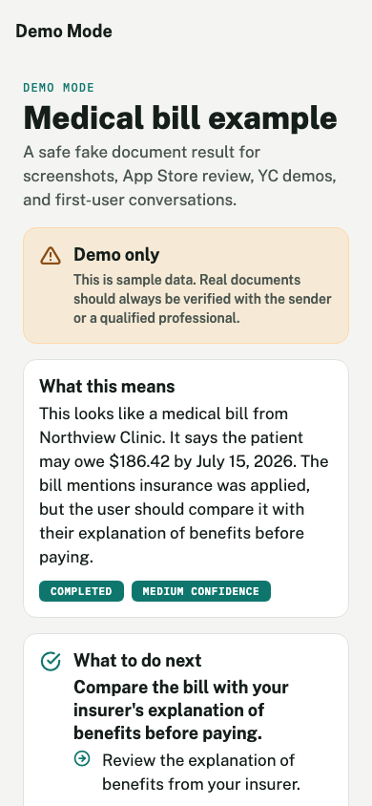
NEXTSTEP
Take a photo of a bill or notice. Know what to do next.
NextStep explains confusing paperwork, finds the amount and deadline, helps set reminders, and keeps proof when it is handled.
Investor deck

Slide 2
NEXTSTEP
Most people just want four answers.
When a bill or notice arrives, the questions are basic and urgent.
What is it?
Do I owe money?
When is it due?
What do I do?
A bill, insurance letter, rent notice, school form, debt letter, or government mail?
If yes, how much and to whom?
What date matters, and what happens if I miss it?
Pay, call, compare, submit, save, or ask someone for help?
NextStep investor deck
02

Slide 3
NEXTSTEP
NextStep turns one document into a short checklist.
The app helps the user move from confusion to an action they can finish.
1
2
3
4
5
Add document
Read facts
Ask questions
Set reminder
Save proof
Take a photo or upload a PDF, screenshot, bill, notice, or form.
Show sender, amount, due date, and required action.
Let the user ask what it means or who to call.
Create a reminder or calendar event before the deadline.
Keep a receipt, confirmation number, note, or photo.
NextStep investor deck
03

Slide 4
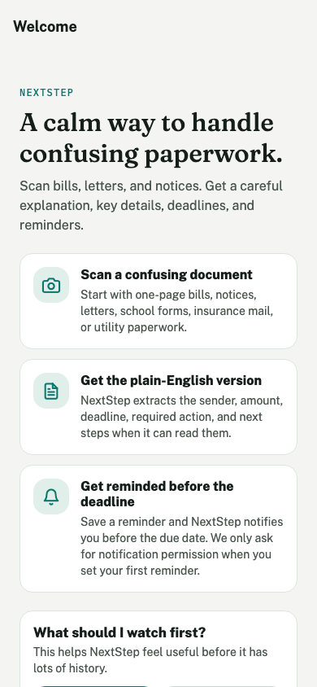
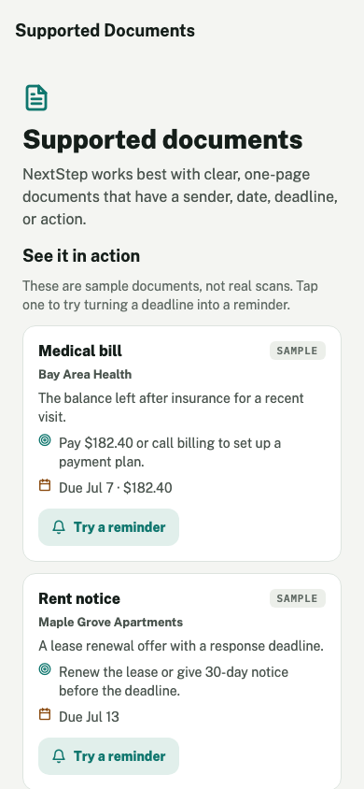
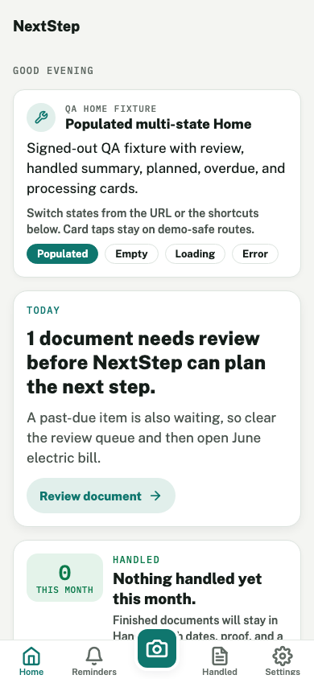
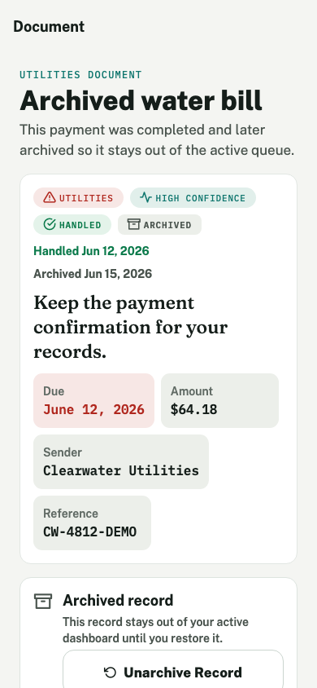
NEXTSTEP
The current app already shows the core experience.
These screens are captured from the current Expo build.
Start
Examples
Answer
Track
Done
NextStep investor deck
04

Slide 5
NEXTSTEP
This starts with painful, common paperwork.
We are not starting with every document. We start where misunderstanding has consequences.
134.8M
91%
41%
63M
U.S. households deal with bills and notices.
U.S. adult smartphone ownership.
U.S. adults reported health care debt in 2022.
Family caregivers often manage paperwork for someone else.
FRED / Census
Pew
KFF
AARP / NAC
First categories
Medical bills, utility bills, rent notices, insurance letters, debt notices, school forms, and government mail.
NextStep investor deck
05

Slide 6
NEXTSTEP
The app does six concrete things.
Each feature maps to a question users already have.
Reads the document
Answers questions
Shows uncertainty
Finds sender, amount, deadline, and required action.
Helps with questions like, Do I need to pay this?
Asks the user to check fields the AI is unsure about.
Sets reminders
Shares with helpers
Keeps proof
Turns due dates into reminders or calendar events.
Connects a document to a parent, partner, roommate, or caregiver.
Stores receipts, confirmation numbers, notes, and photos.
NextStep investor deck
06

Slide 7
NEXTSTEP
The product gets more useful after the first scan.
The first use answers one document. Repeated use creates a history the user can rely on.
Repeated use
First scan
Long-term value
See repeated senders, due dates, reminders, proof, and documents that still need action.
Understand this bill or notice right now.
Know what was paid, submitted, ignored, delegated, or still unfinished.
NextStep investor deck
07

Slide 8
NEXTSTEP
The stack is simple and mobile-first.
Expo handles the app. Supabase stores user data. Edge Functions process documents and reminders.
Mobile app
Backend
AI + reminders
Expo SDK 54
React Native 0.81
React 19
Expo Router
TypeScript
Supabase Auth
Postgres with RLS
Supabase Storage
Edge Functions
Pilot access controls
process-document
ask-document
AI output checks
Expo notifications
Calendar integration
NextStep investor deck
08

Slide 9
NEXTSTEP
The business can start with a subscription.
The paid value is not unlimited scans. It is not missing something important.
Free
Plus
Family
Partners
Limited scans
Basic summaries
Manual reminders
More document history
AI Q&A
Push reminders
Recurring bills
Proof storage
Shared helpers
Household list
Delegated tasks
Caregiver orgs
Benefits teams
Clinics
Nonprofits
Paid reason: avoid missed deadlines and keep proof when something is handled.
NextStep investor deck
09

Slide 10
NEXTSTEP
What we build next is measurable.
The next phase should prove that users scan documents, take action, and come back for reminders.
0-30 days
30-90 days
90-180 days
Improve TestFlight onboarding
Open live upload to approved users
Track scan-to-action conversion
Test AI accuracy by document type
Forward emailed PDFs
Detect recurring bills
Share with family or caregivers
Send reminder summaries
Improve document history
Add human review for risky docs
Find caregiver and benefits partners
Strengthen privacy
NextStep investor deck
10

Slide 11
NEXTSTEP
The next question is simple: will users trust this for real bills?
Use of funds
Metrics to prove
Why now
Pilot launch
AI accuracy tests
Mobile polish
Privacy and security
User interviews
Weekly active users
Scans per user
Reminders created
Documents marked done
Repeat usage
AI can read the document. The product opportunity is helping people act on it and remember the result.
NextStep
Bills and notices, made understandable.

